Slide 1


FULL STACK WEB DEVELOPMENT WITH DJANGO
Lecture 30

Slide 2

Today’s Agenda
Developing Our Django App
Applying Validation
Using Keyword Arguments For Validations
Using Methods For Validation
Using Validators
Using Custom Validators

Slide 3
Applying Validations
Django permits us to add validations to the input fields in three ways:
Using special keyword arguments passed to the FormField while creating the attribute
Defining our own methods for validation
Using validators module
Creating Custom Validators

Slide 4
Using min_length,max_length
When we create CharField or EmailField, then Django allows us to specify two keyword arguments called min_length and max_length.
These arguments specify the minimum and maximum length of the input string.
For example:
name = forms.CharField(min_length=3, max_length=10)
The above code will force the user to input values between 3 to 10 characters only
If not , then error message will be generated

Slide 5
Using min_value,max_value
When we create IntegerField or FloatField, Django allows us to specify two keyword arguments called min_value and max_value.
These arguments specify the minimum and maximum limit of input value.
For example:
age = forms.IntegerField(min_value=18)
The above code will force the user to input atleast 18 or more.
If not , then error message will be generated

Slide 6
A Sample Registration App
To undertstand what we have learnt, lets develop a registration app for a Job portal
The app will ask the user to input
Name
Graduation Year
DOB
Gender

Slide 7
Performing Initial Steps
Load the virtual environment in VS CODE
Create a django project called formdemoproject3 by using the command:
django-admin startproject formdemoproject3
This will create the outer project folder called formdemoproectj3 and inner app folder also by the same name

Slide 8
Performing Initial Steps
Now go to the outer project folder formdemoproject3 and create an app called registerapp by using the command:
django-admin startapp registerapp
Now create a folder called templates in the registerapp followed by an inner folder called registerapp

Slide 9
Performing Initial Steps
Inside templates/registerapp create an HTML files called showcontactform.html
Finally update settings.py so that it contains the name of our app

Slide 10
Performing Initial Steps
Code:
INSTALLED_APPS = [
'django.contrib.admin',
'django.contrib.auth',
'django.contrib.contenttypes',
'django.contrib.sessions',
'django.contrib.messages',
'django.contrib.staticfiles',
‘registerapp',
]

Slide 11
Creating Form Class
The next step will be to create a file called forms,py in our app folder called registerapp
Within the forms.py we will define a class called RegisterForm to create the Registeration Form

Slide 12
Creating Form Class
from django import forms
From datetime import date
class RegisterForm(forms.Form):
name = forms.CharField(min_length=3, max_length=10)
gr_year = forms.IntegerField(min_value=2018,max_value=2020,label="Graduation Year")
dob = forms.DateField(widget=forms.SelectDateWidget(years=range(1980,date.today().year)))
gender=forms.ChoiceField(choices=[(' ','Choose'),('M','Male'), ('F','Female')])

Slide 13
Connecting Form Object To Views
After creating the Form classes, our next task is to render it in the browser for the user
For this we will define a function called showRegistrationForm() in views.py and do the following
Check whether the request is POST
If not then simply create a RegisterForm object and send it to the showregform.htnl template
If it is POST then , create a RegisterForm object with the data filled by the user and call is_valid()
If is_valid() returns true then retrive the filed values and display them in console

Slide 14
The contact( )View Function
from django.shortcuts import render
from registerapp import forms
def showRegistrationForm(request):
if request.method == 'POST':
regform = forms.RegisterForm(request.POST)
print('Bounded form received . Calling is_valid')
if regform.is_valid():
print('is_valid complete')
name = regform.cleaned_data['name']
gr_year = regform.cleaned_data['gr_year']

Slide 15
The contact( )View Function
dob = regform.cleaned_data['dob']
gender=regform.cleaned_data['gender']
print("name:", name)
print("gr_year:", gr_year)
print("dob:", dob)
print('gender:', gender)
else:
regform = forms.RegisterForm()
return render(request,'registerapp/showregform.html',{'form':regform})

Slide 16
Creating The showregform.html Page
<html>
<head>
<title>Contact us</title>
</head>
<body>
<h1>Contact us</h1>
<h3>Sign Up</h3>
<form action=“” method=‘POST’>
{% csrf_token %}
<table>
{{ form }}
</table>
<input type='submit' value='Send' >
</form>
</body>
</html>

Slide 17
Configuring URL
Now we need to create a URL conf so Django can find our new view.
To do this follow the below mentioned steps
Create and open the urls.py in the registerapp folder
Add the following URL pattern to this new urls.py:
from django.urls import path
from . import views
urlpatterns = [
path('',views.showRegistrationForm)
]

Slide 18
Configuring URL
In the VS Code open the file called urls.py in the formdemoproject3 folder and update the code in it as shown below:.
Code (formdemoproj1/urls.py):
from django.contrib import admin
from django.urls import path,include
urlpatterns = [
path('admin/', admin.site.urls),
path('register/',include('registerapp.urls'))
]

Slide 19
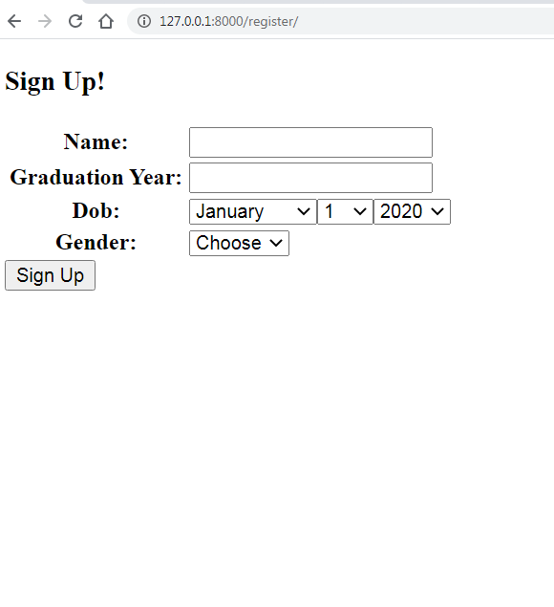
Running The App
Now start the server and open the page http://localhost:8000/register and this will load the page showregform.html with the following output:

Slide 20
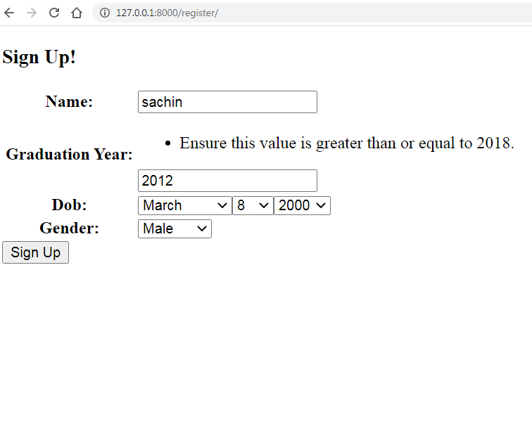
Running The App

Slide 21
Using <fieldname>_clean() Method
Django allows us to validate a particular field using our own logics
The easiest way to validate a single field is to override the method clean_<fieldname>() for the field we want to check.
So for example, we can validate that the age of the user is atleast 18 years according to the entered DOB value.
Similarly we can check whether user has selected gender or not

Slide 22
Steps To Be Done
Define methods by the name of clean_dob() and clean_gender() in the RegisterForm calss.
Add the validation logic in these methods
If the validation fails then raise a ValidationError(‘message’) containing the error message to be displayed
Now , when we will call the is_valid() method from views.py , then Django will automatically call these methods for validating the values

Slide 23
Modified Form Class
from django import forms
From datetime import date
class RegisterForm(forms.Form):
name = forms.CharField(min_length=3, max_length=10)
gr_year = forms.IntegerField(min_value=2018,max_value=2020,label="Graduation Year")
dob = forms.DateField(widget=forms.SelectDateWidget,years=range(1980,date.today().year))
gender=forms.ChoiceField(choices=[(' ','Choose'),('M','Male'), ('F','Female')])

Slide 24
Modified Form Class
def clean_gender(self):
data = self.cleaned_data["gender"]
if data.strip() == "":
raise forms.ValidationError("Please select gender!")
return data

Slide 25
Modified Form Class
def clean_dob(self):
data = self.cleaned_data["dob"]
curryear = date.today().year
byear = data.year
if curryear - byear < 18:
raise forms.ValidationError("You are underage!")
return data

Slide 26
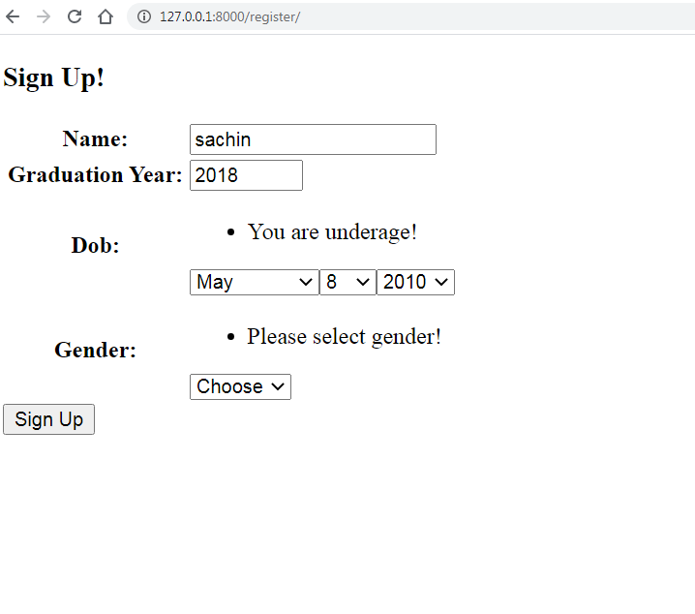
Running The App

Slide 27
Validating All Fields Together
Instead of validating the fields in their specific clean_xxx() method , Django also allows us to write the validation logic at one place.
This place is the clean() method .
We generally use it to perform validation on interdependent fields

Slide 28
Validating All Fields Together
This method belongs to the class forms.Form and thus is inherited by our Form class
It is called by Django when we call the method is_valid() on our Form object and allows us to perform validation which requires access to multiple fields
So for this we must override this method in our Form class.

Slide 29
Validating All Fields Together
While overriding this method we must do 3 things :
Access the values from cleaned_data and apply our own validation logic
If the need arises then raise ValidationError
Finally return cleaned_data dictionary

Slide 30
The Code
def clean(self):
bdate = self.cleaned_data["dob"]
curryear = date.today().year
byear = bdate.year
if curryear - byear < 18:
raise forms.ValidationError("You are underage!")
gender = self.cleaned_data["gender"]
if gender.strip() == "":
raise forms.ValidationError("Please select gender!")
return self.cleaned_data

Slide 31
Exercise
Write an application containing following fields:
Name
Password
ReType Password
Message
Apply validation to check the following:
Message should be atleast of 4 words
Password and Retype Password must match

Slide 32
Solution
from django import forms
class RegisterForm(forms.Form):
name = forms.CharField(min_length=3, max_length=10)
password = forms.CharField(widget=forms.PasswordInput)
retypepassword=forms.CharField(widget=forms.PasswordInput)
message=forms.CharField(widget=forms.Textarea)

Slide 33
Solution
def clean_message(self):
data = self.cleaned_data["message"]
msg_words=data.split()
if len(msg_words)<4:
raise forms.ValidationError("Message should be atleast of 4 words!")
return data

Slide 34
Solution
def clean(self):
pwd = self.cleaned_data["password"]
rpwd= self.cleaned_data["retypepassword"]
if pwd!=rpwd:
raise forms.ValidationError("Password and retype password do not match!")
return self.cleaned_data

Slide 35
Validation Using Validators
The most professional way to apply validation is to use Validators.
A validator is a function which is used for raising ValidationErrors if some conditions aren’t fulfilled.
We pass the name of this function to a keyword argument called validators while creating Form field

Slide 36
Validation Using Validators
There are various validators available in a module called django.core.validators and some of them are
MaxLengthValidator
MinLengthValidator
EmailValidator
URLValidator
We pass these validators as a list to the validators keyword argument while creating the Form field

Slide 37
Using MaxLengthValidator
from django import forms
from django.core import validators
class RegisterForm(forms.Form):
name = forms.CharField(validators=[validators.MaxLengthValidator(10)])
email=forms.EmailField()

Slide 38
Creating Custom Validators
There may be a case where we may need a validator of our own choice, it can be for checking some value or case etc.
We can create our own validator by creating a function and using it for validation

Slide 39
Creating Custom Validators
Following are the steps to do this:
Define a function with one argument which will receive the input field value passed by Django
Perform validation on the value
If the validation fails then raise a ValidationError
Otherwise return the value
Pass the name of this function in the list passed to the validators keyword argument while creating the Form field

Slide 40
Creating Custom Validators
from django import forms
from django.core import validators
def check_for_name(value):
if value[0]!=‘A’:
raise forms.ValidationError(“Name must begin with A”)
else:
return value
class RegisterForm(forms.Form):
name = forms.CharField(validators=[check_for_name])
email=forms.EmailField()

Slide 41
Exercise
Define a custom validator function called validate_email()which checks whether the email entered is a gmail id or not.
If not then raise a ValidationError with the message that we accept only gmail users

Slide 42
Exercise
from django import forms
from django.core import validators
def validate_email(text):
domain = text[text.find("@"):]
if domain.lower() != "gmail.com":
raise forms.ValidationError("We only accept gmail users")
else:
return text
class RegisterForm(forms.Form):
name = forms.CharField(validators=[validators.MaxLengthValidator(10)])
email=forms.EmailField(validators=[validate_email])

